Slide 1
BeWelcome Member Survey 2017
Summary edited 16/07/2017
1

Slide 2
Background & objectives
In the past, BeWelcome had relied on spontaneous feedback in the discussion forum and groups,
email submissions and more recently the Suggestion tool for development.
The General Assembly of BeVolunteer in November 2016 decided that after ten years it was time
to get a more comprehensive understanding of BeWelcome members.
Main Objectives
Understand member activity online and offline
Understand why members are not more active and identify ways to increase activity
Obtain key data on website usage and satisfaction for improvement and assessment of
progress (benchmarking)
2

Slide 3
Methodology
The survey was carried out anonymously online from June 19th to July 9th using LamaPoll.
Approx. 10.000 active members and 10.000 inactive members (not logged in for 12 to 24 months)
were randomly selected among members fluent in English, German, French or Spanish (87% of
membership).
The sample received email invitations to participate in the survey in their main language, with a direct
link to the corresponding questionnaire.
The questionnaire had a total of 35 questions, but many conditional questions were only asked
when relevant based on replies to previous questions.
It typcially took respondents about 10 minutes to complete the survey.
For details, please refer to http://www.bewelcome.org/groups/2351/wiki
Download source of this file: https://downloads.bewelcome.org/surveys/2017_BW_Member_Survey.pdf
3

Slide 4
Sample structure
 |  | Sample | % | Respondents | % | % Replies
 | Total | 19 821 | 100.0% | 851 | 100.0% | 4.3%
STATUS | "active" | 9 831 | 49.6% | 686 | 80.6% | 7.0%
 | "inactive" | 9 988 | 50.4% | 165 | 19.4% | 1.7%
GENDER | male | 11 050 | 55.7% | 553 | 65.0% | 5.0%
 | female | 7 941 | 40.1% | 275 | 32.3% | 3.5%
 | other | 455 | 2.3% | 23 | 2.7% | 5.1%
 | hidden | 383 | 1.9% | N/A | N/A | N/A
LANGUAGE | en | 8 233 | 41.5% | 345 | 40.5% | 4.2%
 | es | 4 756 | 24.0% | 140 | 16.5% | 2.9%
 | de | 3 773 | 19.0% | 220 | 25.9% | 5.8%
 | fr | 3 059 | 15.4% | 146 | 17.2% | 4.8%
HOSTING | YES | 9 986 | 50.4% | 299 | 35.1% | 3.0%
 | MAYBE | 4 704 | 23.7% | 365 | 42.9% | 7.8%
 | NO | 4 139 | 20.9% | 187 | 22.0% | 4.5%
Interestingly respondents with the hosting status « YES » participated significantly less than the others.
4

Slide 5
Note
Please bear in mind that the data is declarative and that its accuracy depends on respondents' memory and honesty (which we encouraged by allowing the feedback to be anonymous).
It is representative of those who participated in the survey. While we managed to make it reasonably representative of the BeWelcome membership on many aspects, inactive members (no login for 12 months, 75% of members) are under-represented in the total results. Their responses have been analysed separately and reported when relevant. We cannot force anyone to have their voices heard and only have data from those who contributed. From our cross checks with the member database most data seems accurate, some of it may be less reliable.
The usefulness of the data will increase with the consistent repetition of the survey and tracking of changes.
Each of the following charts displays at the bottom the exact question asked (English version) and the number of respondents.
5

Slide 6
Results
6

Slide 7
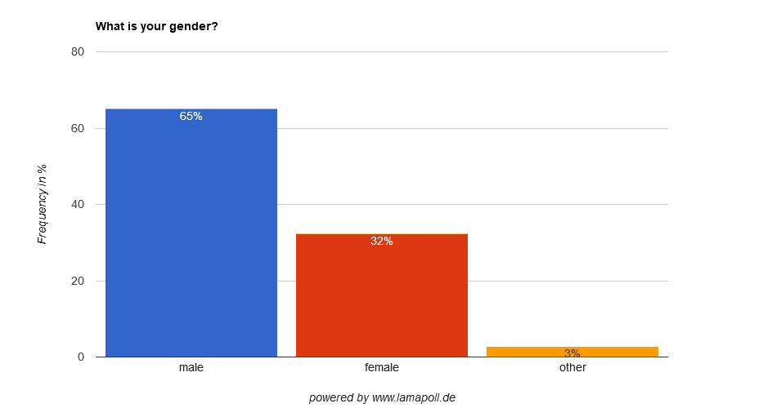
One third of respondents was female (vs. 40% among those invited to take the survey)
1 What is your gender?
851 respondents
7

Slide 8
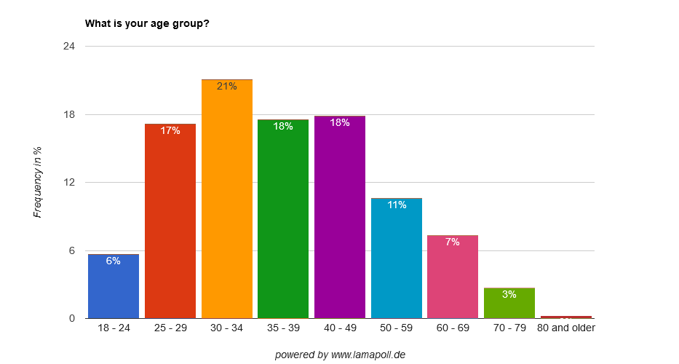
The average age of respondents was 39.5 years (higher than the average age of BeWelcome members, which is 33 years)
2 What is your age group?
851 respondents
8

Slide 9
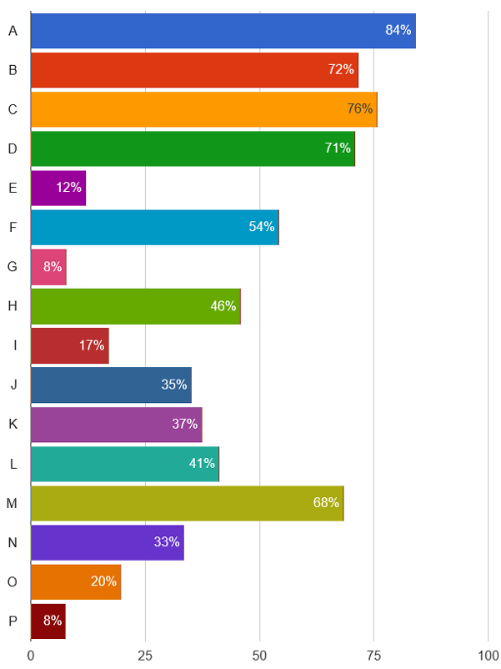
Main reasons for joining
to stay with locals when traveling
Forum discussions and offline activities
were reasons for joining for very few members
The youngest age group joined more for traveling, meeting people and saving money, less for hosting. Yet they don’t travel more.
No other really significant differences by age.
to meet new people
to host travelers in my home
to learn about other cultures
to organize activities or events
to save money when traveling
to have forum discussions with others
to be part of a community of like-minded p.
out of curiosity
it’s free to use
it is based on open-source software
it is driven by volunteers
it is non-profit
to practice foreign languages
to participate in activities or events
other
3 Our members have different reasons for joining BeWelcome. Please select all which apply to you:
851 respondents
9

Slide 10
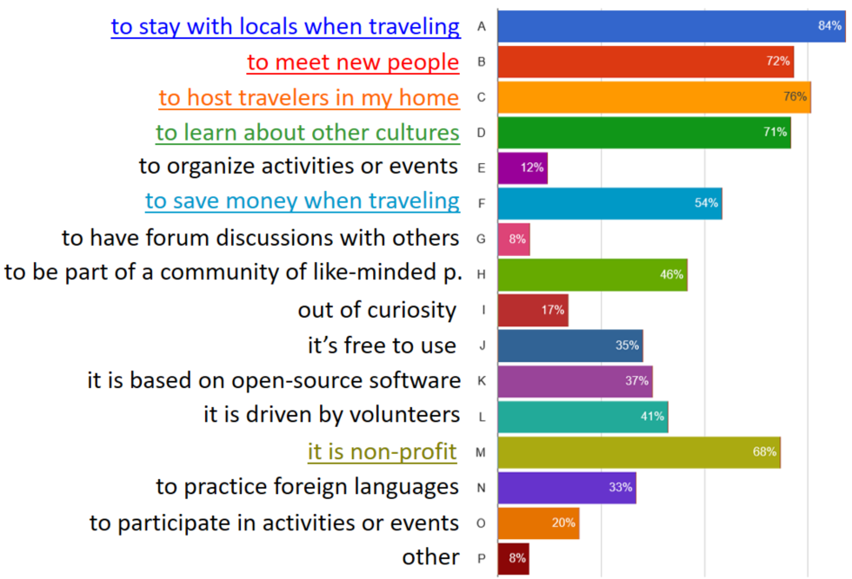
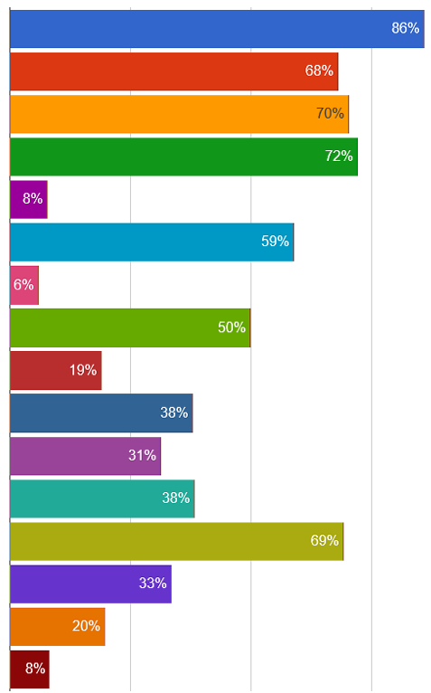
No significant differences by gender in reasons for joining
all
female
3 Our members have different reasons for joining BeWelcome. Please select all which apply to you:
851 / 275 respondents
10

Slide 11
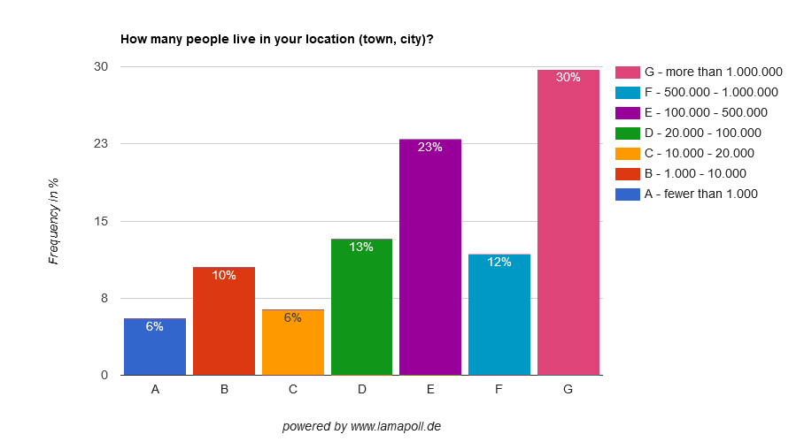
Respondents live in locations of all sizes, with a higher occurrence of mid-size and large cities
4 How many people live in your location (town, city)?
851 respondents
11

Slide 12
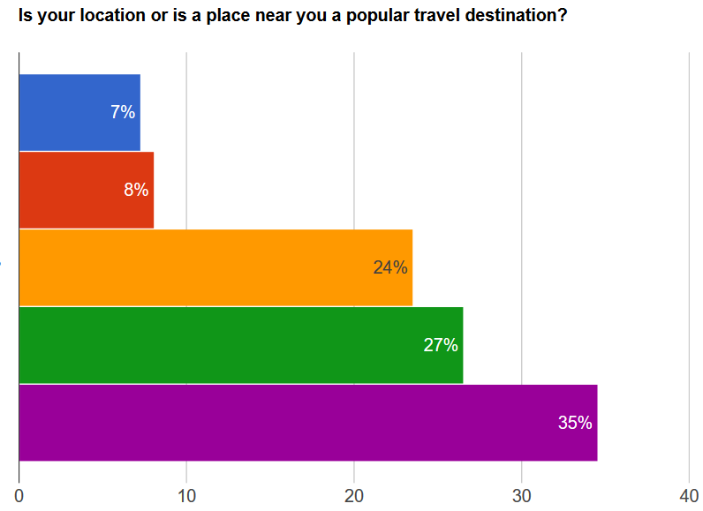
Most respondents live in popular travel destinations
1 = not popular at all
2
3
4
5 = very popular
5 Is your location or is a place near you a popular travel destination?
Rate from 1 = not popular at all to 5 = very popular
851 respondents
12

Slide 13
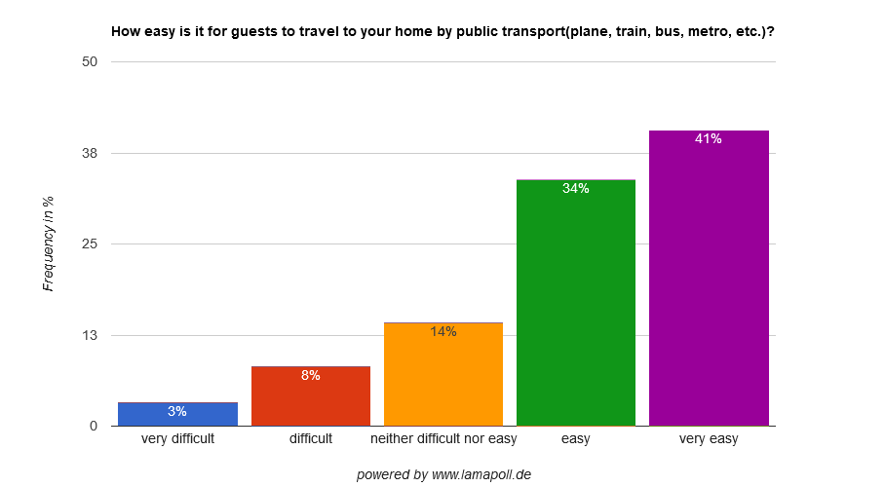
Respondents’ homes can be easily reached by public transport
6 How easy is it for guests to travel to your home by public transport (plane, train, bus, metro, etc.)?
851 respondents
13

Slide 14
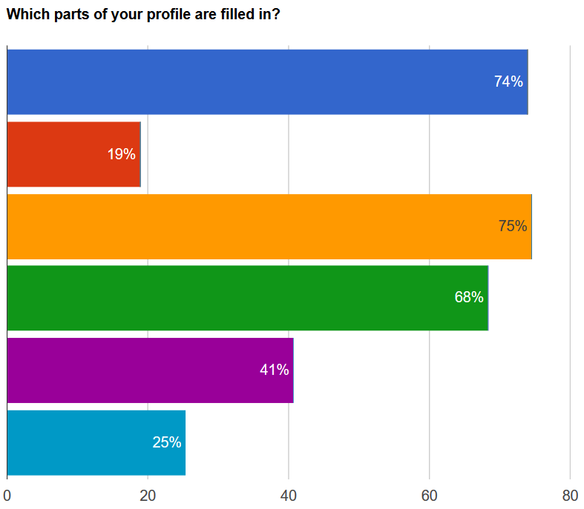
3 of 4 say they have a profile photo and filled in the accommodation section
Surprisingly among those who offer
to host (YES and MAYBE), there
aren’t more who say they have a
profile photo or filled the accommo-
dation section.
In the youngest age group only
1 of 2 say they have a profile photo.
main profile photo of myself
other photo on which I am
not recognizable
« about me » section
accommodation section
other sections
don’t know which sections filled
7 Which parts of your profile are filled in? Please select all the parts which you remember having filled:
851 respondents
14

Slide 15
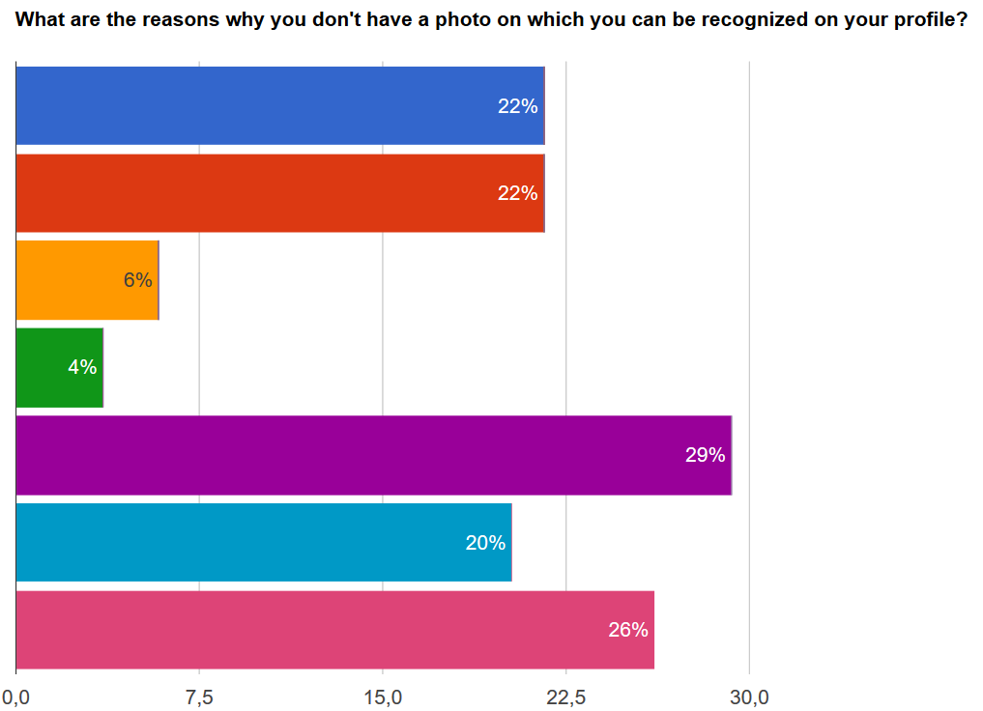
The reasons for not uploading a profile photo are varied. Only 3 % say they don’t know how.
I don't believe it is necessary
I prefer not to show myself
I don't have a picture of myself
which I would like to show
I don't know how to add a picture
I haven't thought of it
I haven't had time
Other
8 What are the reasons why you don't have a photo on which you can be recognized on your profile? Please select all reasons which apply:
285 respondents
15

Slide 16
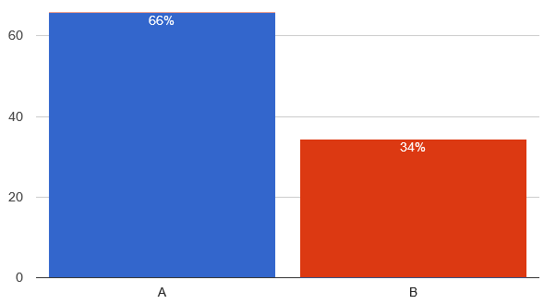
2/3 of respondents say they have logged into the website during the past 6 months
Yes
This data is rather accurate as the actual data among active users invited is 60%.
Only the inactive respondents, who had been set to « inactive » for not logging in for at least 12 month, overestimate their last login since 1/4 of them also say they have logged in during the past 6 months.
No
9 As far as you can remember, have you logged into the BeWelcome website during the past 6 months (before receiving the invitation to this survey)?
851 respondents
16

Slide 17
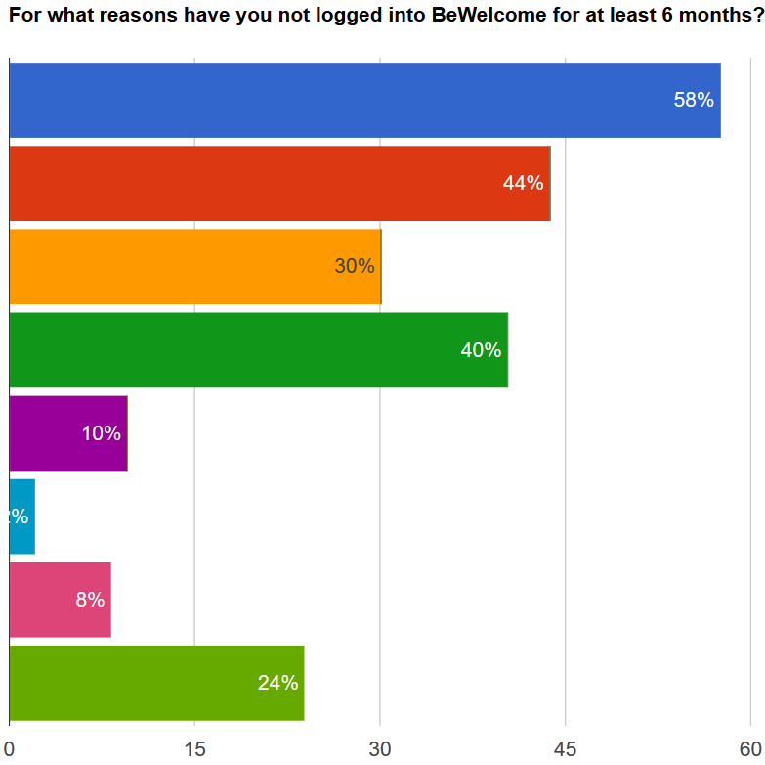
Main reasons for not logging in:
not receiving requests, traveling and having forgotten about BeWelcome
Among the « other » reasons: not being able to host, and not finding hosts
I haven't received any accommodation requests
I wasn't traveling anywhere
I was using other options for accommodation
I kind of forgot about BeWelcome
I find the website too difficult to use
I am afraid of using the website to contact people I don't know
I only registered for using BeWelcome later
Other reasons
10 For what reasons have you not logged into BeWelcome for at least 6 months?
Please select all reasons which apply:
292 respondents
17

Slide 18
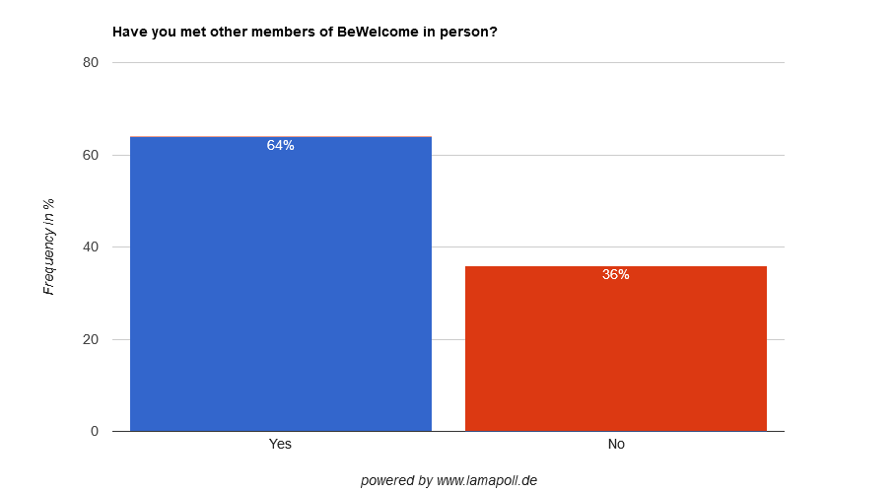
Most respondents have met other members in person
Even 48% of inactive members say they have met other members in person
11 Have you met other members of BeWelcome in person?
851 respondents
18

Slide 19
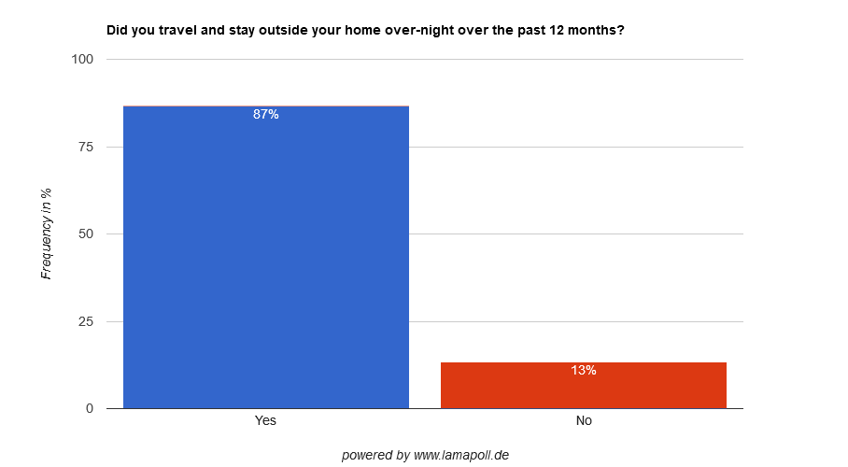
Almost all respondents have traveled and stayed overnight over the past 12 months
The numbers are the
same for respondents
who have not logged in
for 6 months or more
12 Did you travel and stay outside your home over-night over the past 12 months?
851 respondents
19

Slide 20
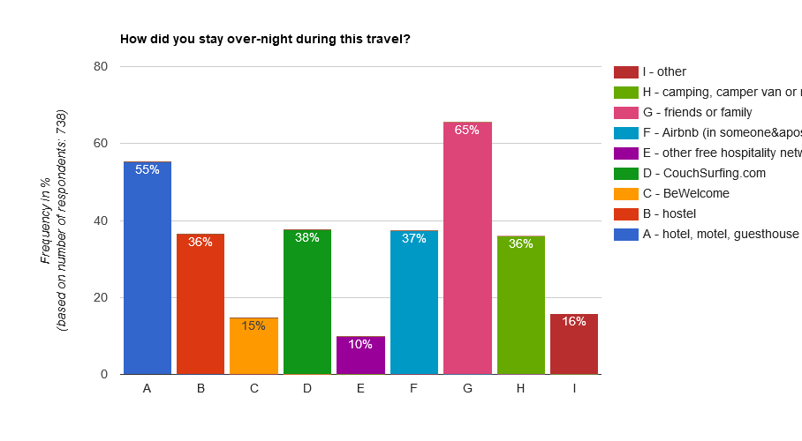
Of all choices offered, BeWelcome is the option least used for staying overnight (15%). Of these 15%, a third has stayed with a BW host more than once over the past 12 months.
CS
BW
13 How did you stay over-night during this travel? Please select all which apply:
15 How many times have you stayed with a BeWelcome host over the past 12 months?
738 / 108 respondents
20

Slide 21
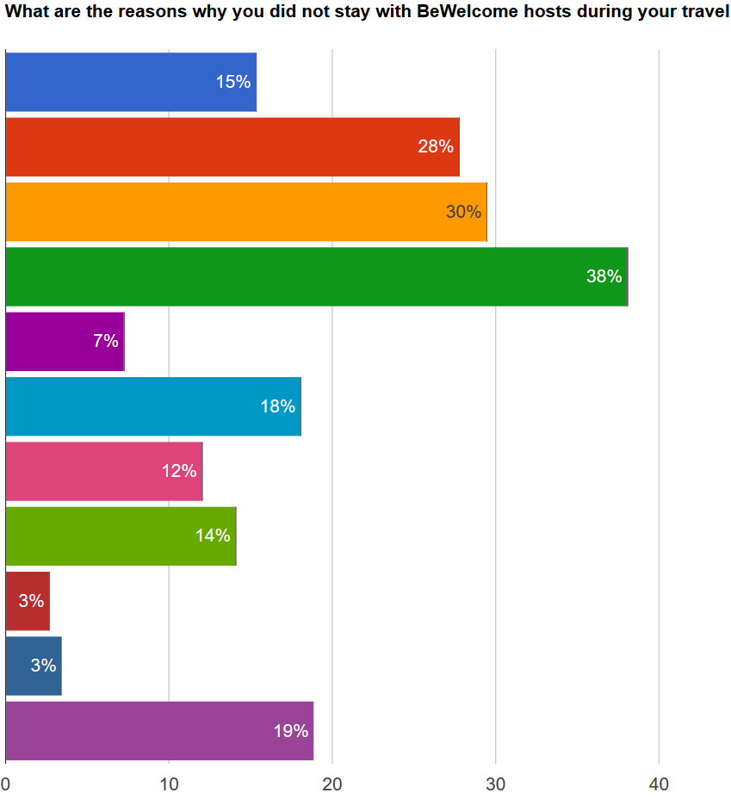
Main reasons given for not staying with a BeWelcome host:
preferred to be independent
didn't think about looking for accommodation through BW
already had accommodation
didn't find a host through BeWelcome
wanted more comfort
traveling with someone who preferred to stay differently
accommodation was paid for by someone else (e.g. employer)
no time to search for accommodation through BeWelcome
was concerned how safe it would be
Safety concerns are rarely
the reason given
could not figure out how to use BeWelcome
other
14 What are the reasons why you did not stay with BeWelcome hosts during your travel over the past 12 months. Please select all which apply:
630 respondents
21

Slide 22
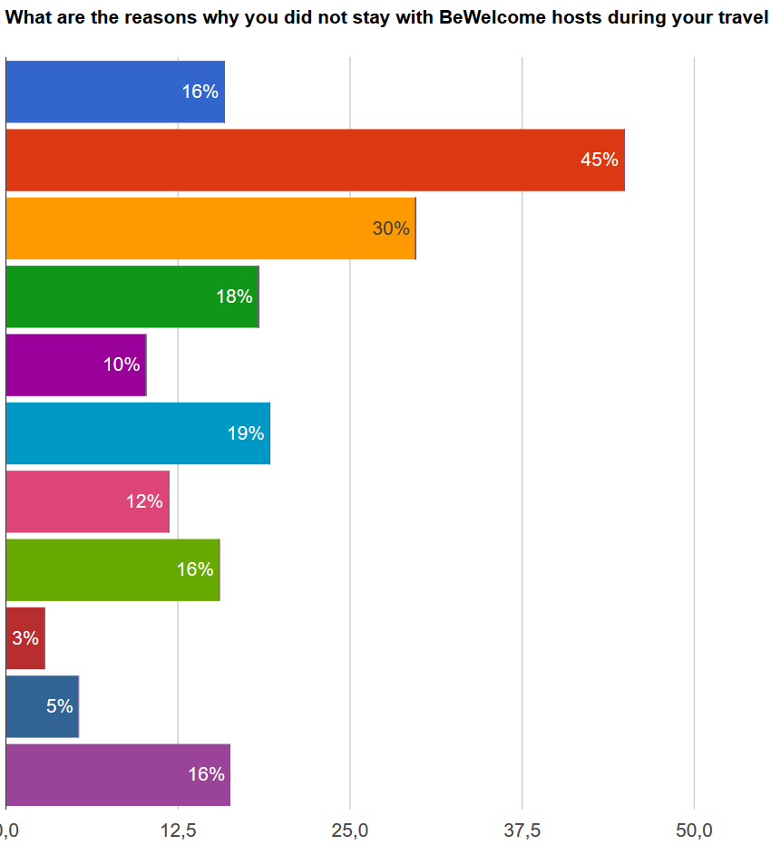
Main reasons given for not staying with BeWelcome host by less active members*:
preferred to be independent
didn't think about looking for accommodation through BW
already had accommodation
didn't find a host through BeWelcome
wanted more comfort
traveling with someone who preferred to stay differently
accommodation was paid for by someone else (e.g. employer)
no time to search for accommodation through BeWelcome
was concerned how safe it would be
could not figure out how to use BeWelcome
other
14 What are the reasons why you did not stay with BeWelcome hosts during your travel over the past 12 months. Please select all which apply:
*not logged in for 6 months (Q9)
245 respondents
22

Slide 23
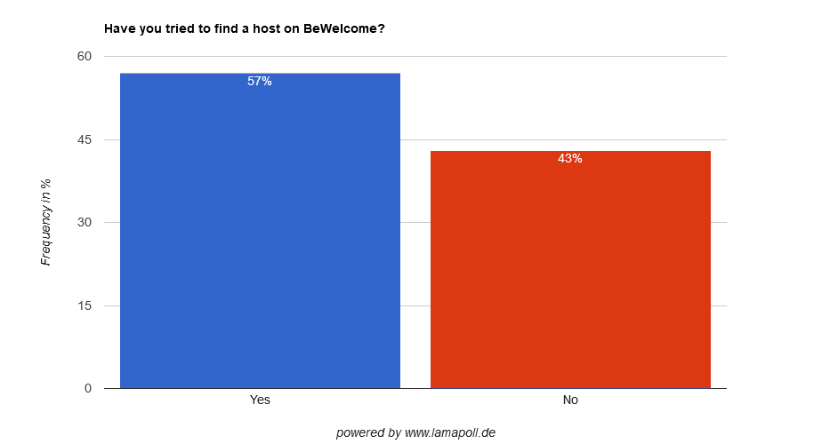
Most have tried to find a host on BeWelcome
No difference by gender,
but in the youngest age
group 75% tried.
17 Have you tried to find a host on BeWelcome?
851 respondents
23

Slide 24
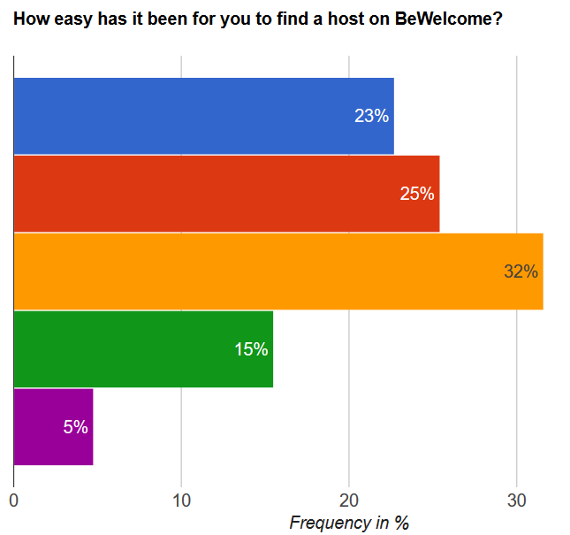
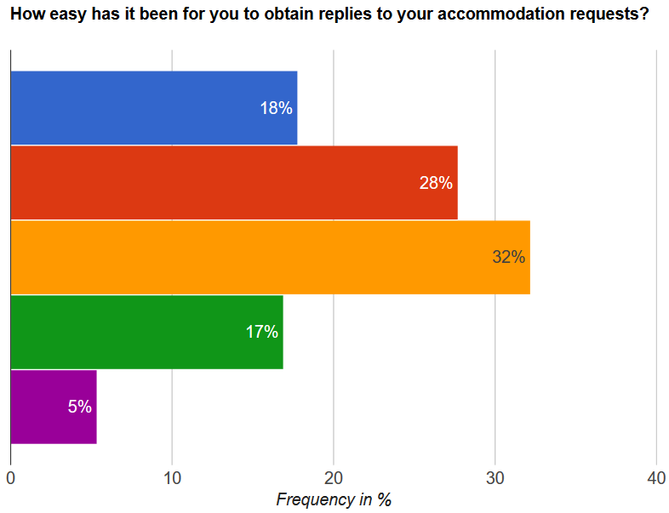
Most have found it difficult to find a host, and even to obtain replies to request
very difficult
difficult
neither nor
easy
very easy
18 How easy has it been for you to find a host on BeWelcome? Rate from 1 = very difficult to 5 = very easy
19 How easy has it been for you to obtain replies to your accommodation requests? Rate from 1 = very difficult to 5 = very easy
507 respondents
24

Slide 25
Most, male or female, have found it difficult to find a host
all
female
very difficult
21%
difficult
26%
neither nor
33%
easy
18%
very easy
4%
18 How easy has it been for you to find a host on BeWelcome? Rate from 1 = very difficult to 5 = very easy
507 / 160 respondents
25

Slide 26
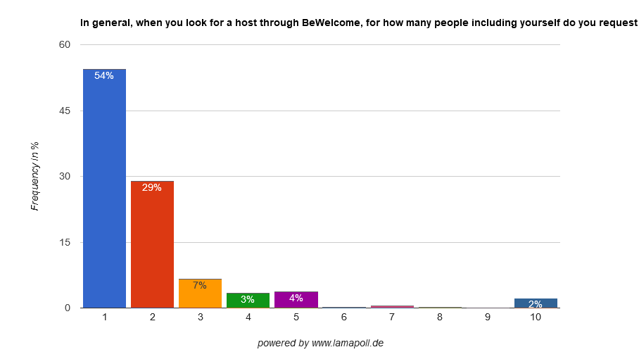
Most look for a host just for themselves. Female members travel in pairs somewhat more often.
20 In general, when you look for a host through BeWelcome, for how many people including yourself do you request accommodation?
484 respondents
26

Slide 27
Most popular destinations
Germany and France are the countries in which most respondents have looked for hosts.
The USA (9%) are the most popular non-European destination in 5th place behind Spain and Italy.
1 | Germany | 107 | 24.2%
2 | France | 92 | 20.8%
3 | Spain | 54 | 12.2%
4 | Italy | 51 | 11.5%
5 | United Kingdom | 38 | 8.6%
5 | United States | 38 | 8.6%
7 | Austria | 23 | 5.2%
8 | Portugal | 21 | 4.8%
9 | Netherlands | 20 | 4.5%
10 | Denmark | 18 | 4.1%
11 | Switzerland | 18 | 4.1%
12 | Greece | 17 | 3.9%
13 | Belgium | 16 | 3.6%
14 | Poland | 16 | 3.6%
15 | Sweden | 16 | 3.6%
16 | Finland | 15 | 3.4%
17 | Thailand | 15 | 3.4%
18 | Japan | 14 | 3.2%
21 In which of these countries have you tried to find a host through BeWelcome over the past 12 months? Please select all where you have tried:
442 respondents
27

Slide 28
Origine (profile location) of respondents who have looked for hosts
1 | Germany | 110 | 24.9%
2 | France | 76 | 17.2%
3 | United States | 28 | 6.3%
4 | Italy | 23 | 5.2%
5 | Spain | 19 | 4.3%
6 | Switzerland | 16 | 3.6%
7 | Argentina | 15 | 3.4%
8 | Netherlands | 12 | 2.7%
8 | Canada | 12 | 2.7%
10 | Belgium | 11 | 2.5%
11 | United Kingdom | 10 | 2.3%
12 | Australia | 9 | 2.0%
12 | Denmark | 9 | 2.0%
12 | Columbia | 9 | 2.0%
15 | Poland | 8 | 1.8%
15 | Czech Republic | 8 | 1.8%
17 | Austria | 6 | 1.4%
18 | Portugal | 5 | 1.1%
442 respondents
28

Slide 29
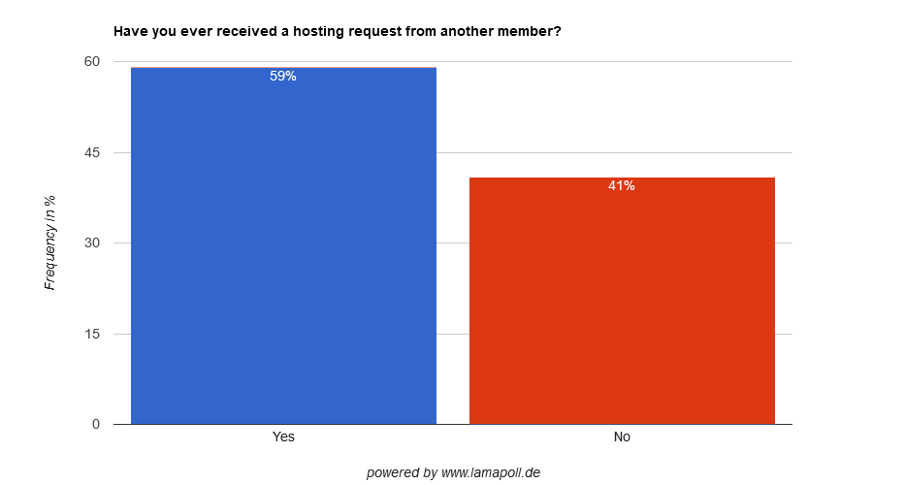
Most respondents have already received a hosting request
No difference by gender
22 Have you ever received a hosting request from another member?
851 respondents
29

Slide 30
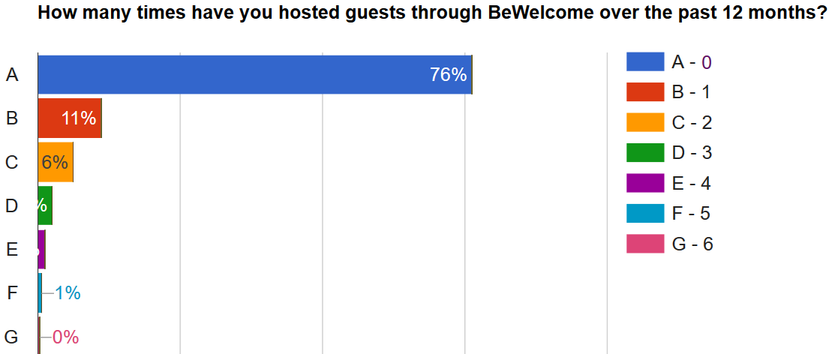
But 3 of 4 respondents have not hosted anyone over the past 12 months
0
1
2
3
3%
4
1%
5
6
16 How many times have you hosted guests through BeWelcome over the past 12 months?
851 respondents
30

Slide 31
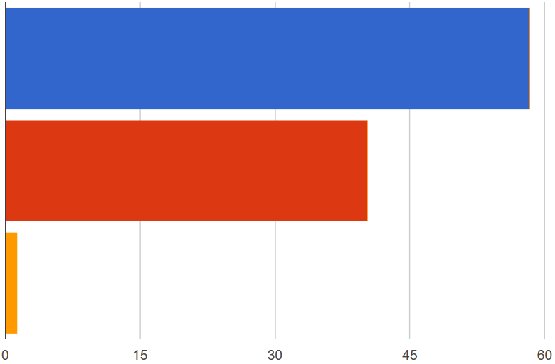
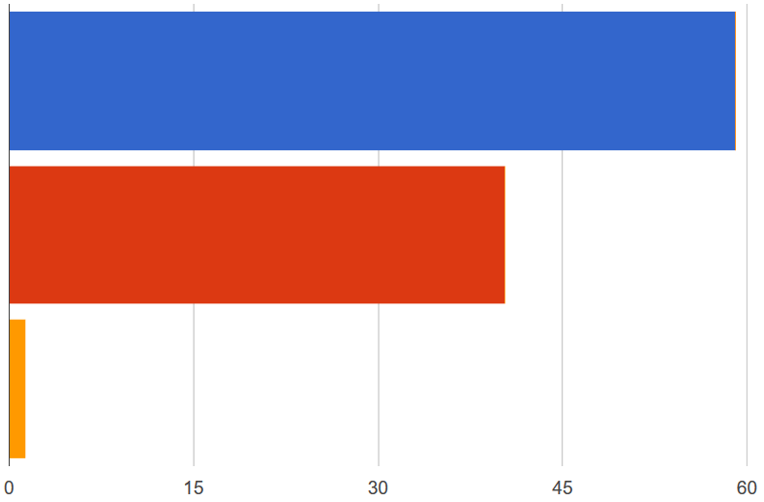
Almost nobody receives too many requests. Most say they don’t receive enough.
All
Respondents who have not logged in for 6 months
58%
I don't receive enough requests
59%
40%
I receive about the right number of requests
40%
1%
I receive too many requests
1%
23 Overall, how satisfied have you been with the number of requests you have received?
851 / 235 respondents
31

Slide 32
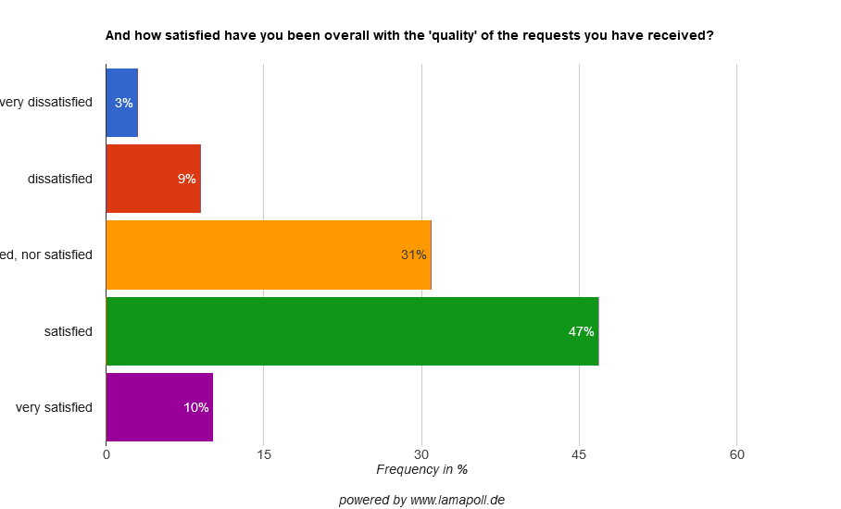
Most are satisfied with the quality of the requests they have received. Very few are dissatisfied.
24 And how satisfied have you been overall with the 'quality' of the requests you have received?
501 respondents
32

Slide 33
Main reasons for the (rare) dissatisfaction with the quality or requests are not enough information and too impersonal requests
25 Why have you not been satisfied with the quality of the hosting requests which you have received?
60 respondents
33

Slide 34
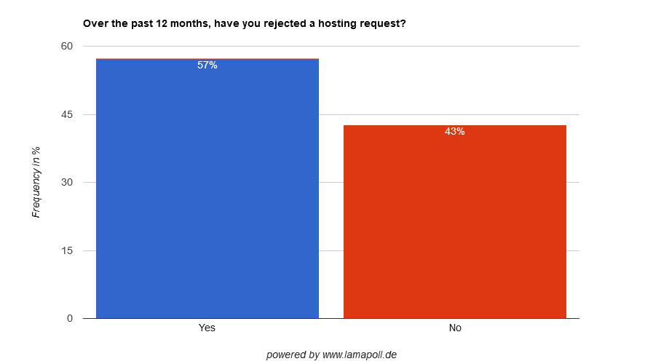
Most have rejected a hosting request over the past 12 months
26 Over the past 12 months, have you rejected a hosting request?
501 respondents
34

Slide 35
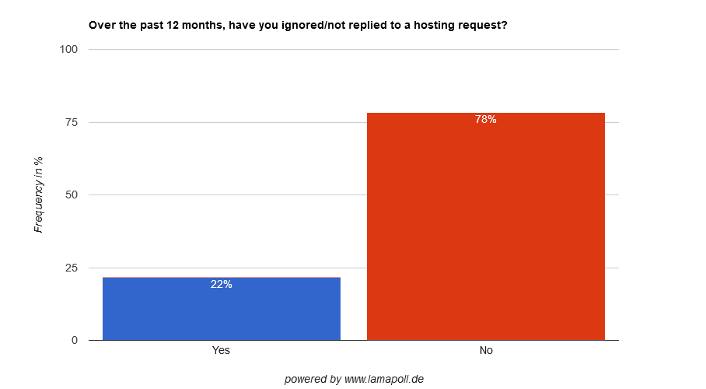
Few say they have ignored a hosting request
27 Over the past 12 months, have you ignored/not replied to a hosting request?
501 respondents
35

Slide 36
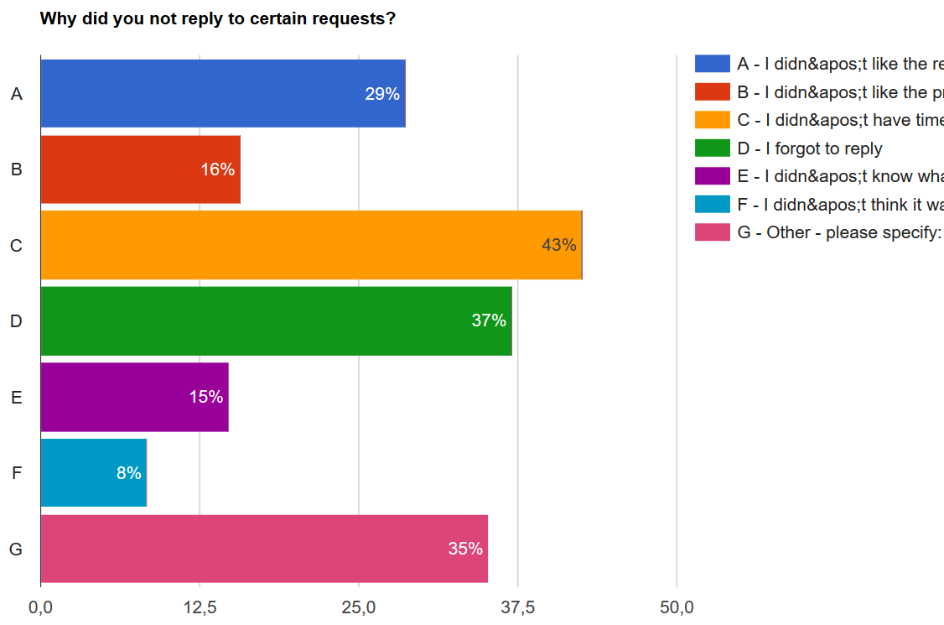
For the few who say they have ignored a hosting request, the main reasons given are:
I didn't like the request(s)
I didn't like the profile(s)
I didn't have time to reply
I forgot to reply
I didn't know what to reply
I didn't think it was necessary to reply
Other
28 Why did you not reply to certain requests? Please select all the reasons which apply:
108 respondents
36

Slide 37
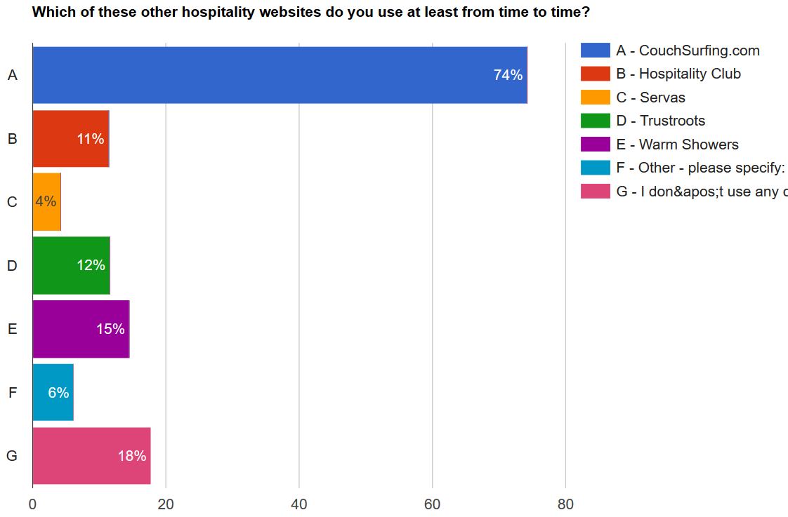
82% use other hospitality websites, almost all of these use CouchSurfing
29 Which of these other hospitality websites do you use at least from time to time? Please select all which apply:
851 respondents
37

Slide 38
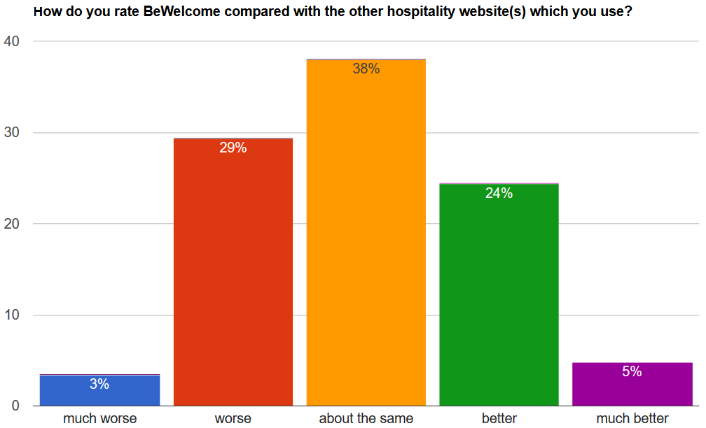
The satisfaction with BeWelcome is similar as with the other hospitality websites which respondents use
30 How do you rate BeWelcome compared with the other hospitality website(s) which you use?
700 respondents
38

Slide 39
The satisfaction of Couchsurfing users with BW is identical with that of the entire sample
all 700 respondents using other hospitality websites:
481 CouchSurfers who replied:
Much worse 4%
Worse 29%
About the same: 37%
Better: 25%
Much Better: 5%
30 How do you rate BeWelcome compared with the other hospitality website(s) which you use?
481 usable responses of 632
39

Slide 40
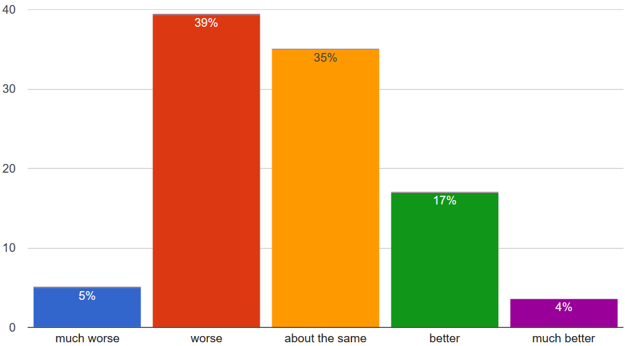
Members who have used CS over the past 12 months to be hosted are somewhat less satisfied with BeWelcome:
respondents who have stayed with CS hosts
during past 12 months
all 700 respondents using other hospitality websites
30 How do you rate BeWelcome compared with the other hospitality website(s) which you use?
277 respondents
40

Slide 41
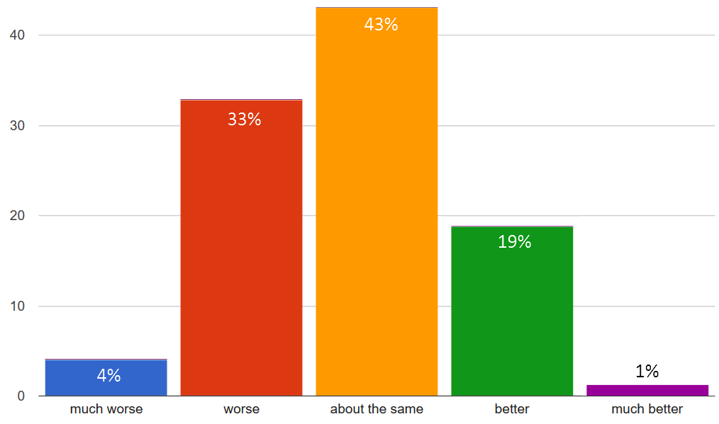
Respondents who have not logged in for 6 months also rate BeWelcome slightly worse
all 700 respondents using other hospitality websites
Respondents who have not logged in for 6 months
30 How do you rate BeWelcome compared with the other hospitality website(s) which you use?
235 respondents
41

Slide 42
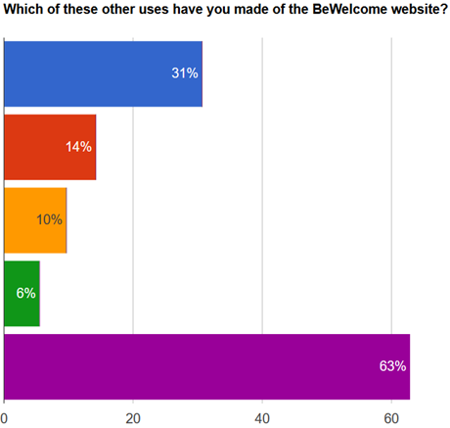
Most have not made any other use of BeWelcome beside hosting or searching for hosts
read group or forum discussions
1 of 3 has read forum discussions,
but fewer than half of these have
posted themselves.
participated in group or forum discussions
participated in an activity or event
organized an activity or event myself
none of the above
31 Which of these other uses have you made of the BeWelcome website? Please select all which apply:
851 respondents
42

Slide 43
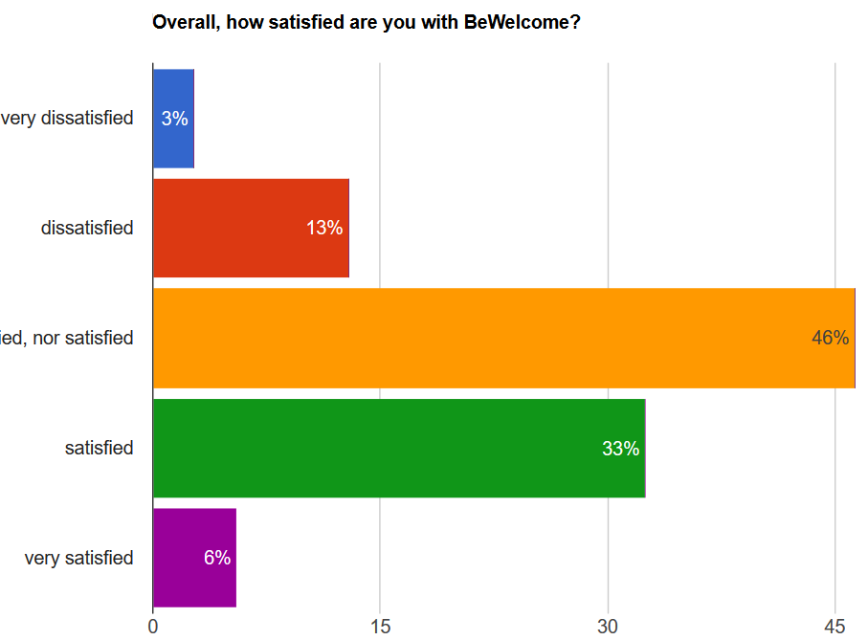
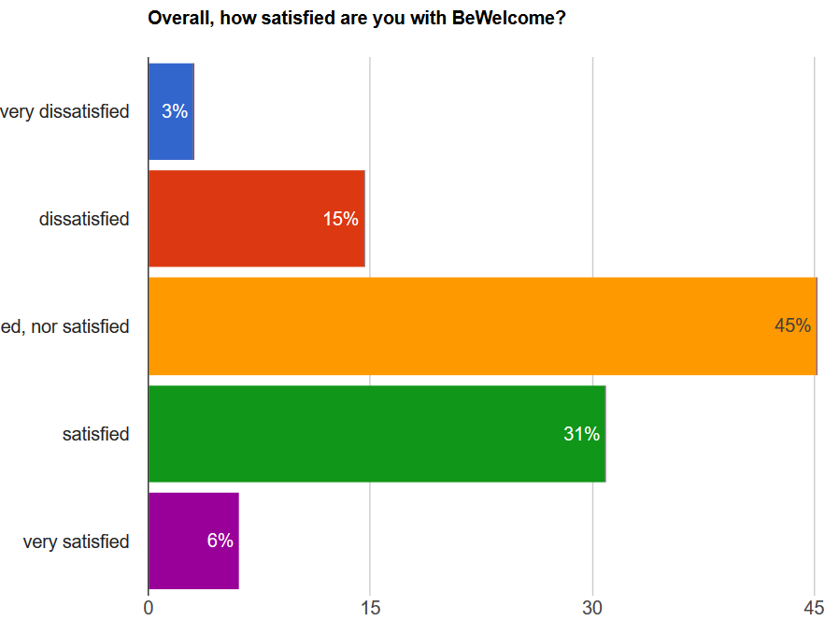
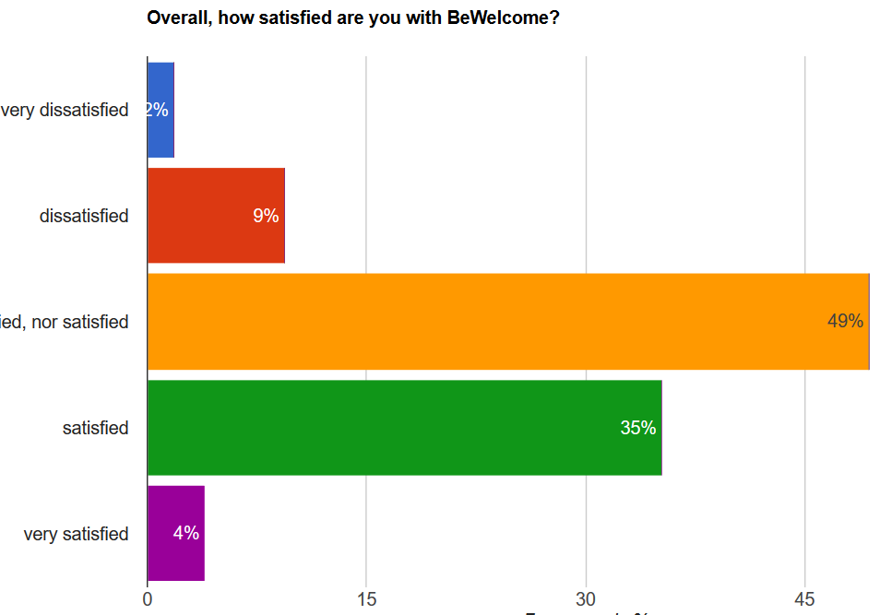
18% of male and 11% of female respondents are dissatisfied with BeWelcome
all
male
female
32 Overall, how satisfied are you with BeWelcome?
851 / 553 / 275 respondents
43

Slide 44
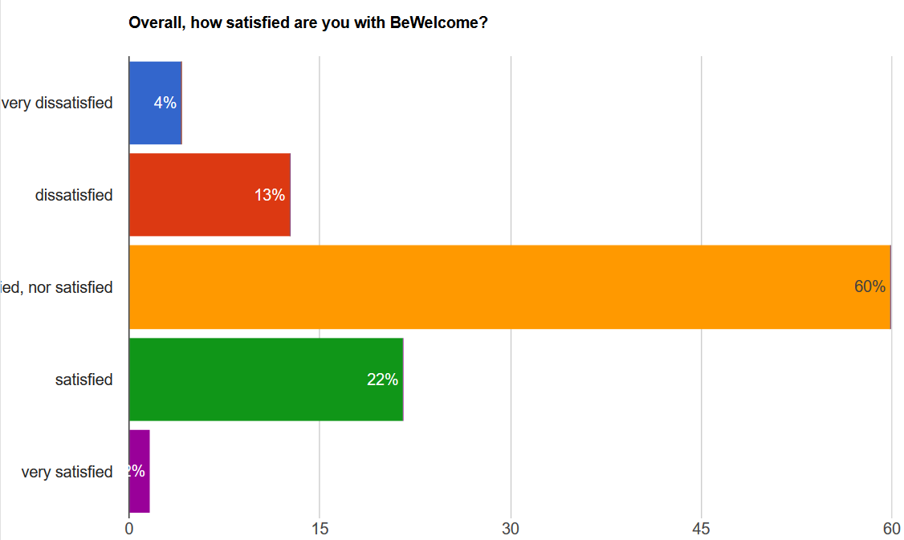
The less active users are less satisfied with BW, but not more dissatisfied
all
Have not logged in during past 6 months
32 Overall, how satisfied are you with BeWelcome?
292 respondents
44

Slide 45
The improvements requested most are more hosts/easier search and more guests for all sub-samples
% of respondents | Definitely not | Rather not | Neutral | Yes | Yes, very much | Total Yes
more hosts | 1% | 3% | 28% | 35% | 33% | 69%
easier member search | 1% | 5% | 41% | 36% | 18% | 54%
more guests | 2% | 4% | 45% | 30% | 19% | 49%
mobile-friendlier | 4% | 7% | 48% | 22% | 20% | 42%
a feature which allows me not to receive accommodation requests for certain dates | 3% | 7% | 42% | 35% | 13% | 48%
more offline events/activities | 5% | 10% | 51% | 23% | 11% | 34%
faster website | 4% | 8% | 59% | 20% | 9% | 30%
a feature which allows me to influence how many accommodation requests I receive | 6% | 12% | 53% | 21% | 8% | 29%
easier to use groups/forum structure | 5% | 8% | 58% | 19% | 9% | 28%
more interesting forum discussions | 7% | 10% | 61% | 15% | 7% | 22%
33 Would you like BeWelcome to work on the following improvements? Please take into account that we won't be able to work on everything at the same time and rate the improvements which are really important for you higher than those which would just be good to have.
851 respondents
45

Slide 46
Other requested improvements
203 of 851 respondents asked for other improvements in the free-text field provided for the purpose
Often these were more detailed comments on the improvements already covered in the preceding question
Main requests were again:
more active members
easier host search
a mobile app (or use of BeWelcome on mobile devices)
Many want to do things which are already possible but apparently not known or understood (such as radius search or search by country, keyword – admittedly limited –, or username), so that a better explanation would help until these features can be made more intuitive or effective.
A number of request may lead to good improvements, such as search by maximum number of guests, the ability to see on a member’s profile or in search results if you have exchanged messages, or to see events in a larger radius or in any location worldwide.
34 Are there any other important improvements which you want BeWelcome to make?
203 respondents
46

Slide 47
Summary
The main reasons for joining BeWelcome are the desire to be hosted by locals and to host travelers, meeting new people and learning about other cultures. Being non-profit is a strong motivation as is saving money.
The reasons for not uploading a profile photo, usually a requirement to host or be hosted, are varied, ranging from not having thought about it and not thinking it is necessary over preferring not to show oneself and not having had time. Not knowing how is rarely the reason.
The main reasons given for not logging in for a long time are not receiving requests and having forgotten about BeWelcome, but surprisingly also traveling oneself (and apparently not using BeWelcome during that time).
Most say they have met other members in person, and most have already received a hosting request. So BeWelcome is not just some website or a collection of profiles. However, 3 of 4 have not hosted anyone over the past 12 months. Most say they don’t receive enough requests, almost nobody receives too many.
47

Slide 48
Summary - continued
Almost all (87%!) have travelled and stayed overnight over the past 12 months, but only 15% of them with BeWelcome (vs. 38% with CS!). 3 of 4 are members of CS, and they keep using Couchsurfing to find hosts. Main reasons given for that are that they didn’t find a BW host and that they didn’t think about looking on BW. Overall they aren’t significantly less satisfied with BW.
Most have tried to find a host on BeWelcome and most have found it difficult not only to find one, but even to obtain a reply. When asked, though, very few admit to having ignored a hosting request. But those who do say it was because they didn’t have time, forgot, and only in third place that they didn’t like the request.
The satisfaction with BeWelcome is the same as with the other hospitality websites respondents use.
Male users and users who have not logged in for 6 months are somewhat less satisfied with BeWelcome.
Forum and activities have not been important reasons for joining, have been used little and are not a focus for improvement requested by respondents.
What they want most by far are more hosts and more guests, easier member search and a mobile-friendlier website.
48

Slide 49
Summary - continued
On a final note: While fewer members participated in the survey than we would have hoped, the comments by those who did were overwhelmingly positive and encouraging regarding the survey itself, the work which volunteers do to make BeWelcome happen in general, and the non-profit character in particular. This feedback alone, in addition to the useful guidance for future development and the ability to now track progress, has made the work put into this first survey worthwhile.
49

